Slide 1
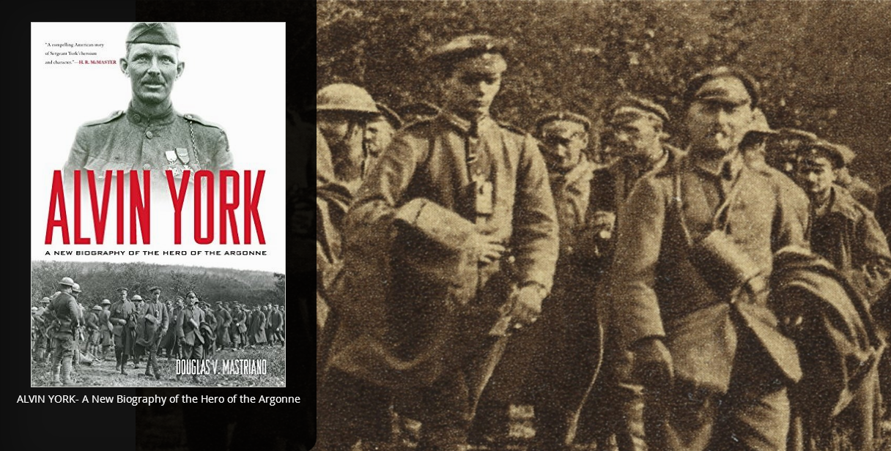

Slide 2
An example of how you can make a difference in life

Slide 3
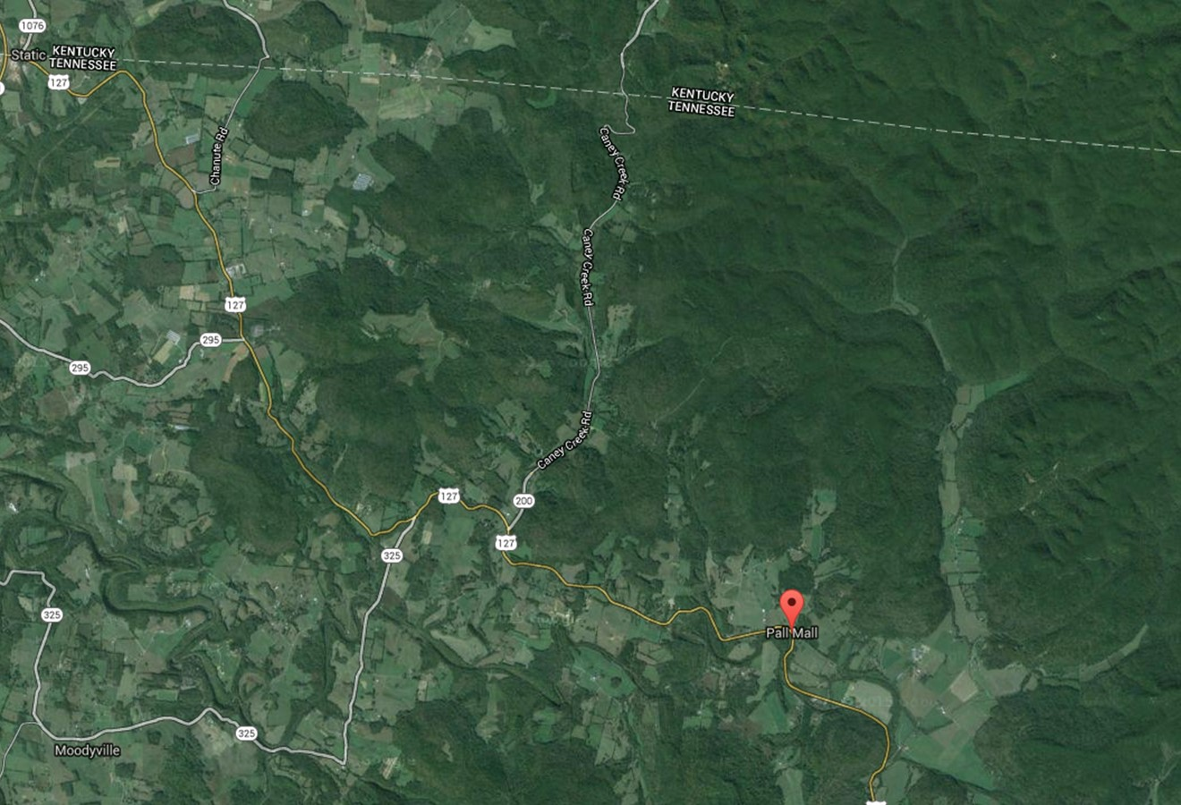
Good for nothing drunk…
Gracie
Character muscle
Notes:
But God hath chosen the foolish things of the world to confound the wise; and God hath chosen the weak things of the world to confound the things which are mighty…
1 Corinthians 1:27

Slide 4
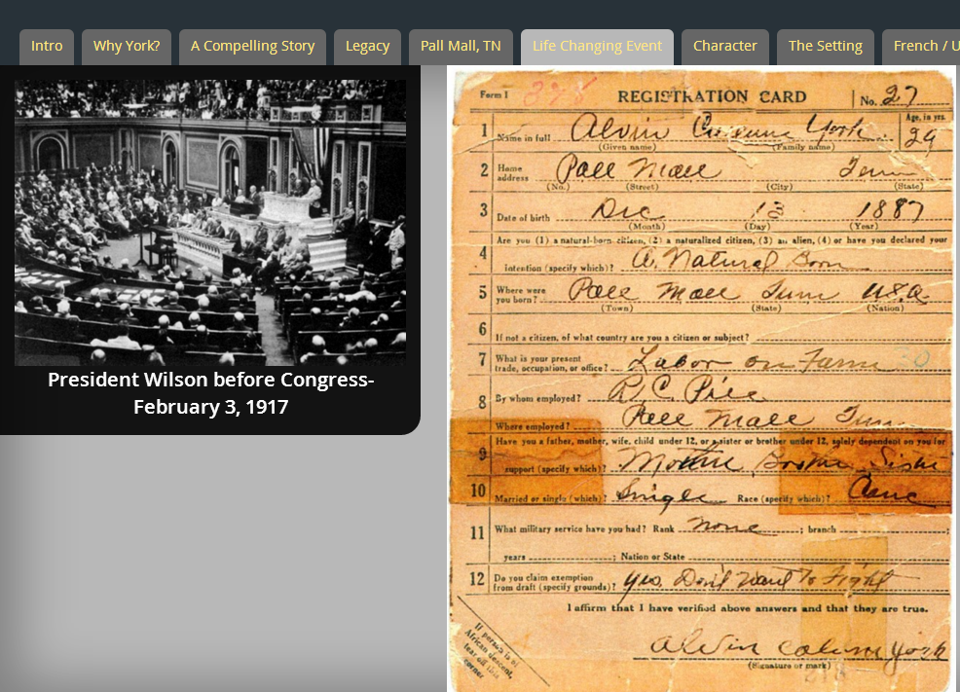
Next York?
Influence?
Buxton and Danforth

Slide 5
Building the Character Muscle
“Good men better…
…bad men worse.”

Slide 7
There are acts of courage that turn men into heroes

Slide 9
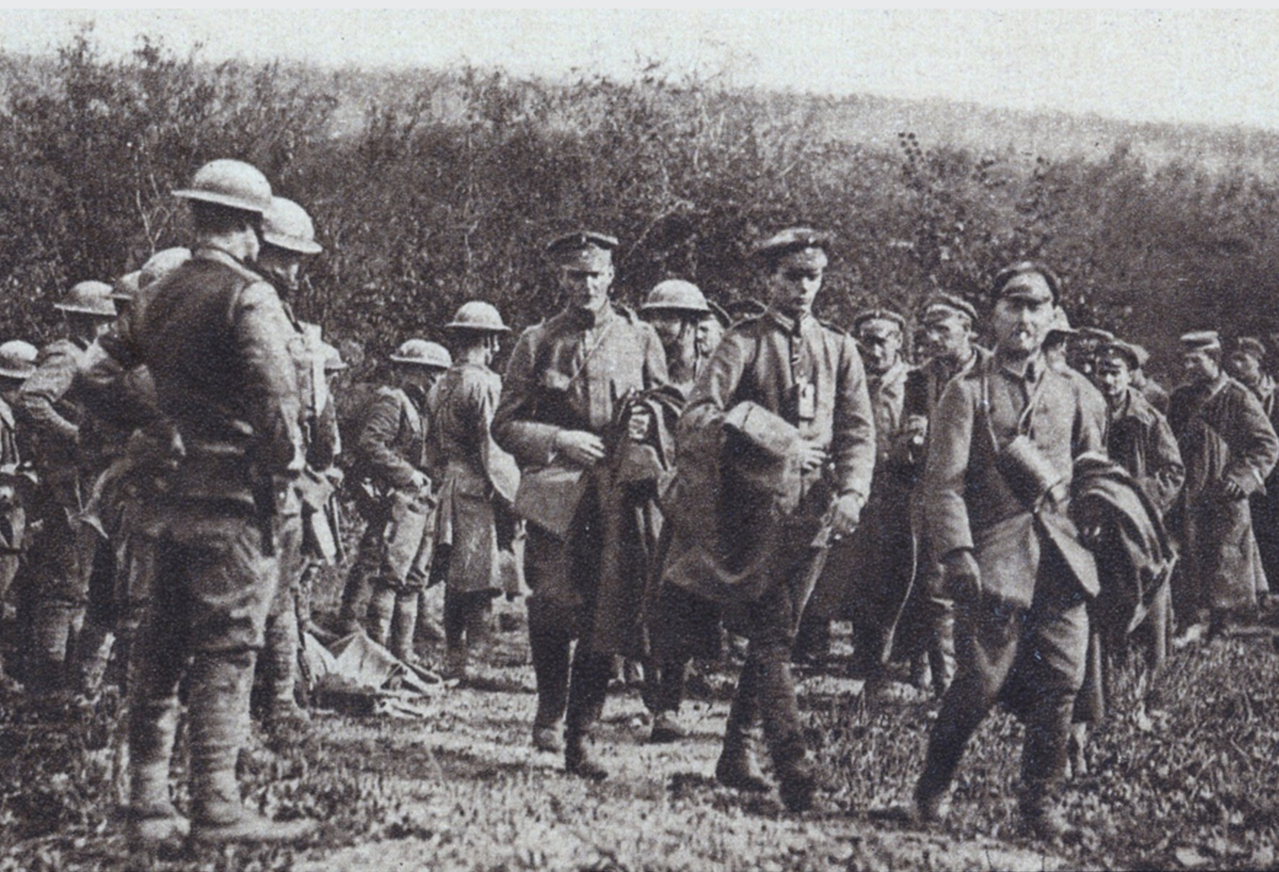
A today that changes a century of tomorrows…

Slide 12
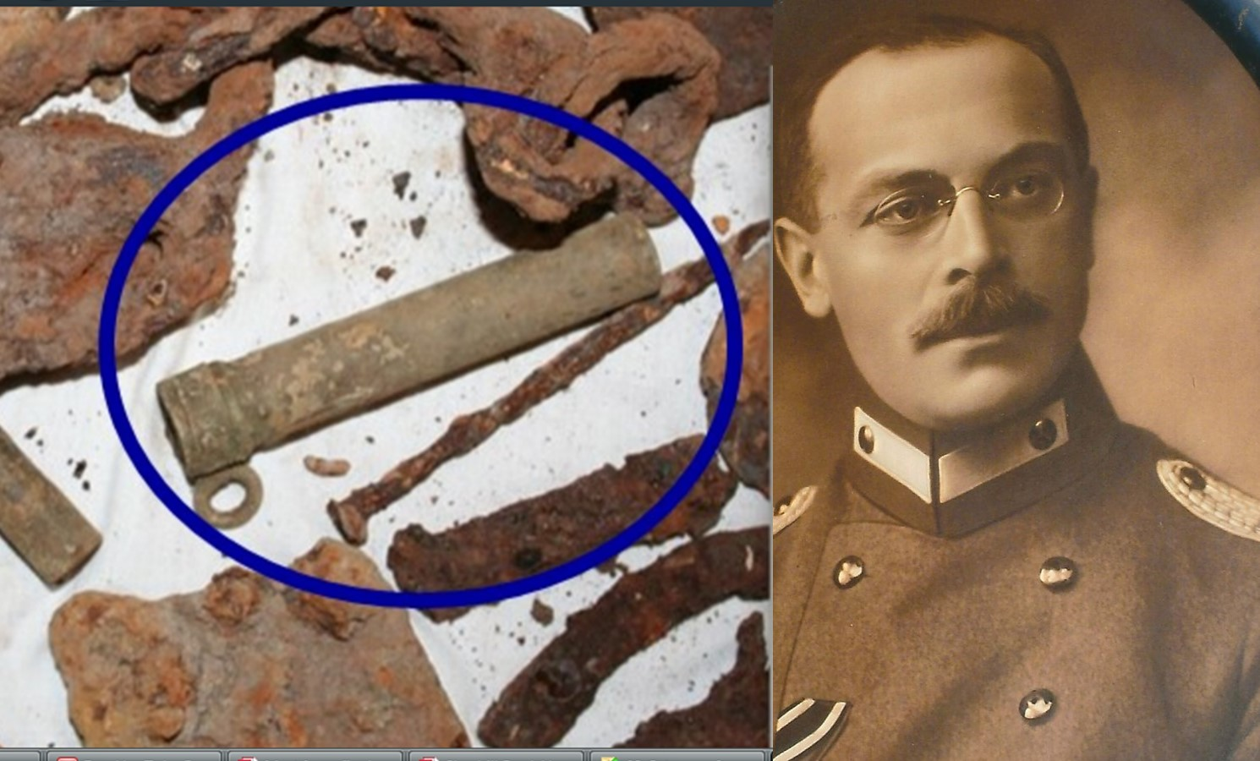

Slide 13
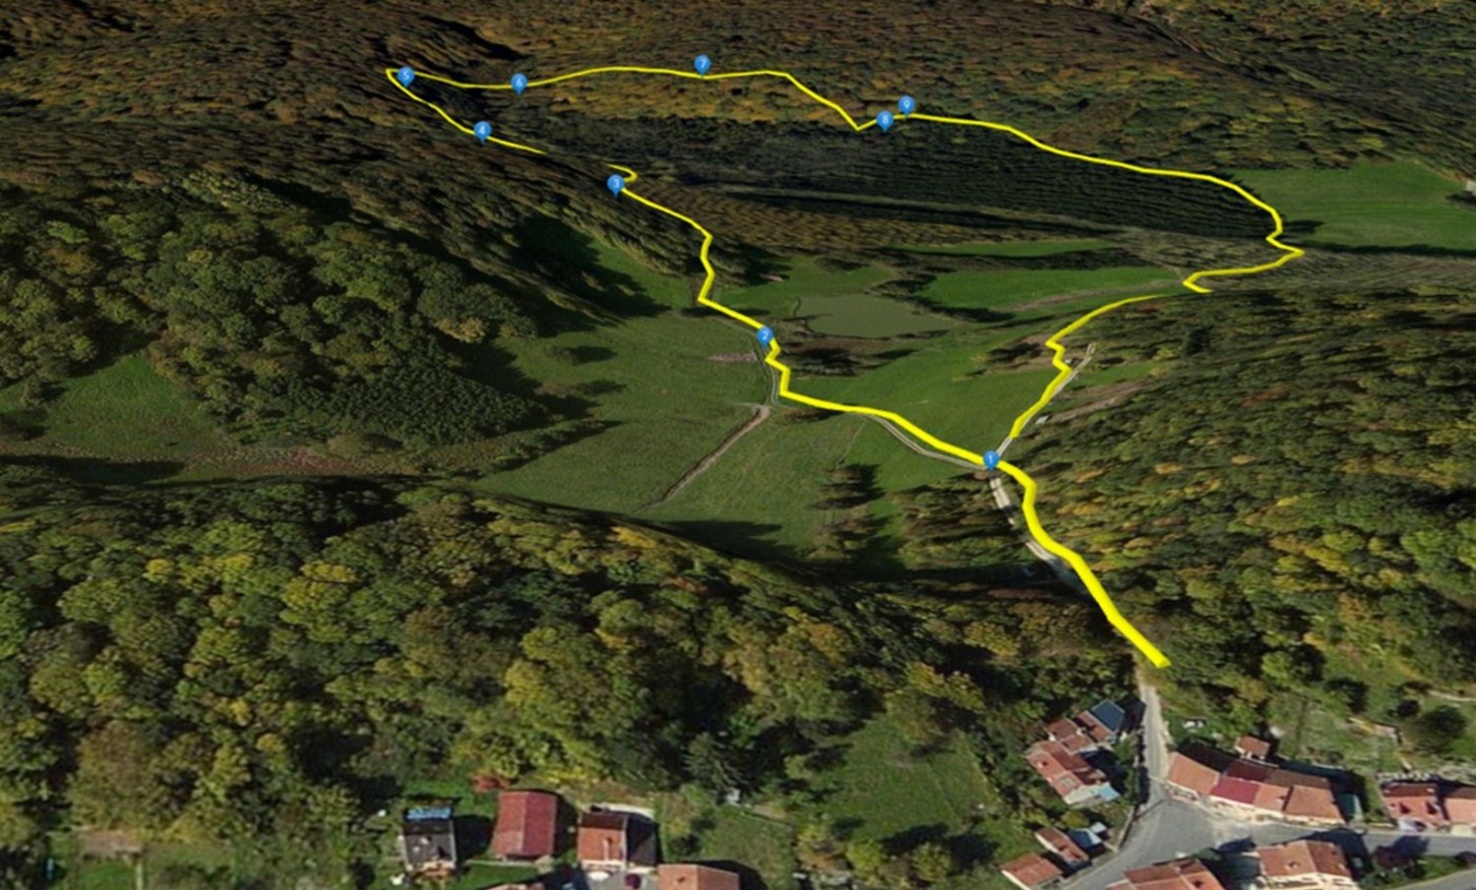

Slide 15
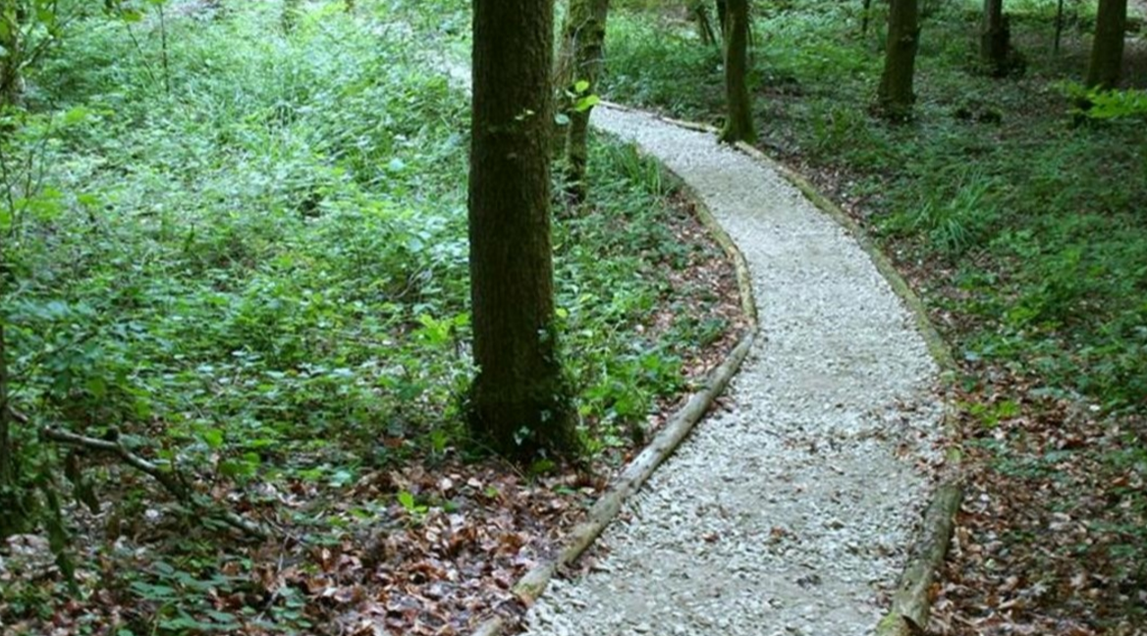

Slide 16
